Slide 1
Branch4
BART Analytics

Slide 2
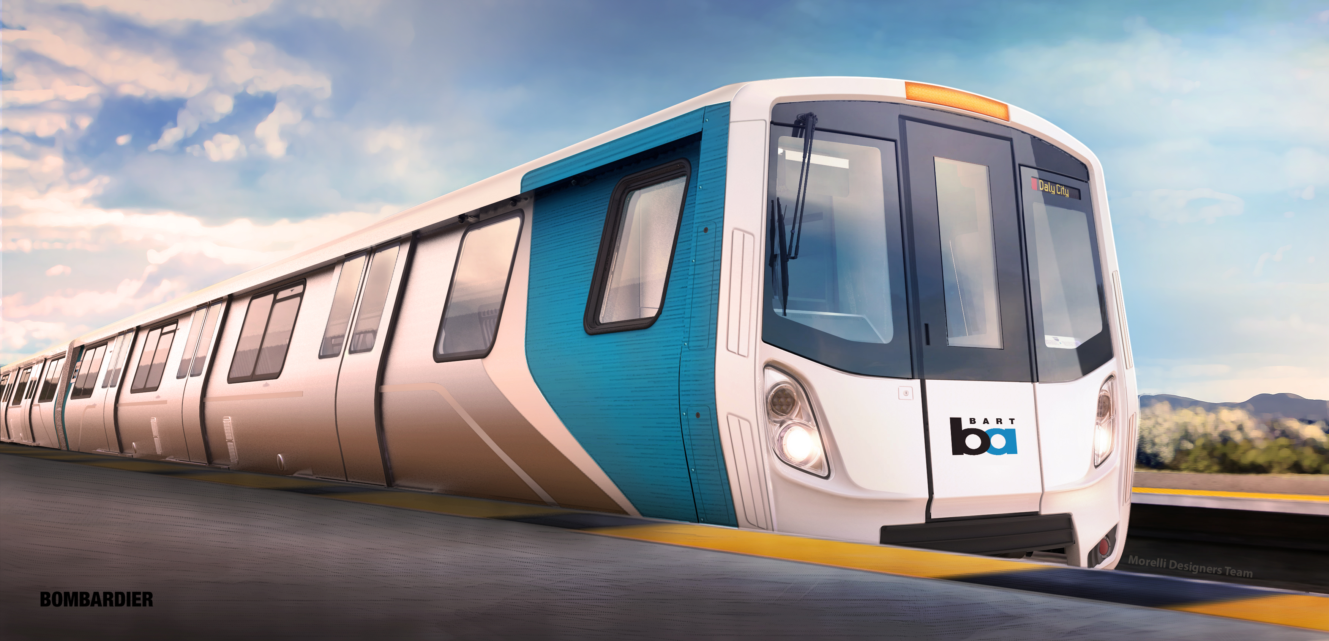
To ride or not to ride Bart?
That is the question

Slide 3
Questions
What are the ridership yearly trends? What does the seasonality look like?
Hourly trends – when should I ride Bart if I don’t want a crowded train?
Was there an effect from a “Big Event” in 2016 to ridership?
Where people are exiting/boarding Bart the most?
Bart delays last ~2yrs
Weather affected?
Trends: When not to ride BART…

Slide 4
BART Seasonality

Slide 7
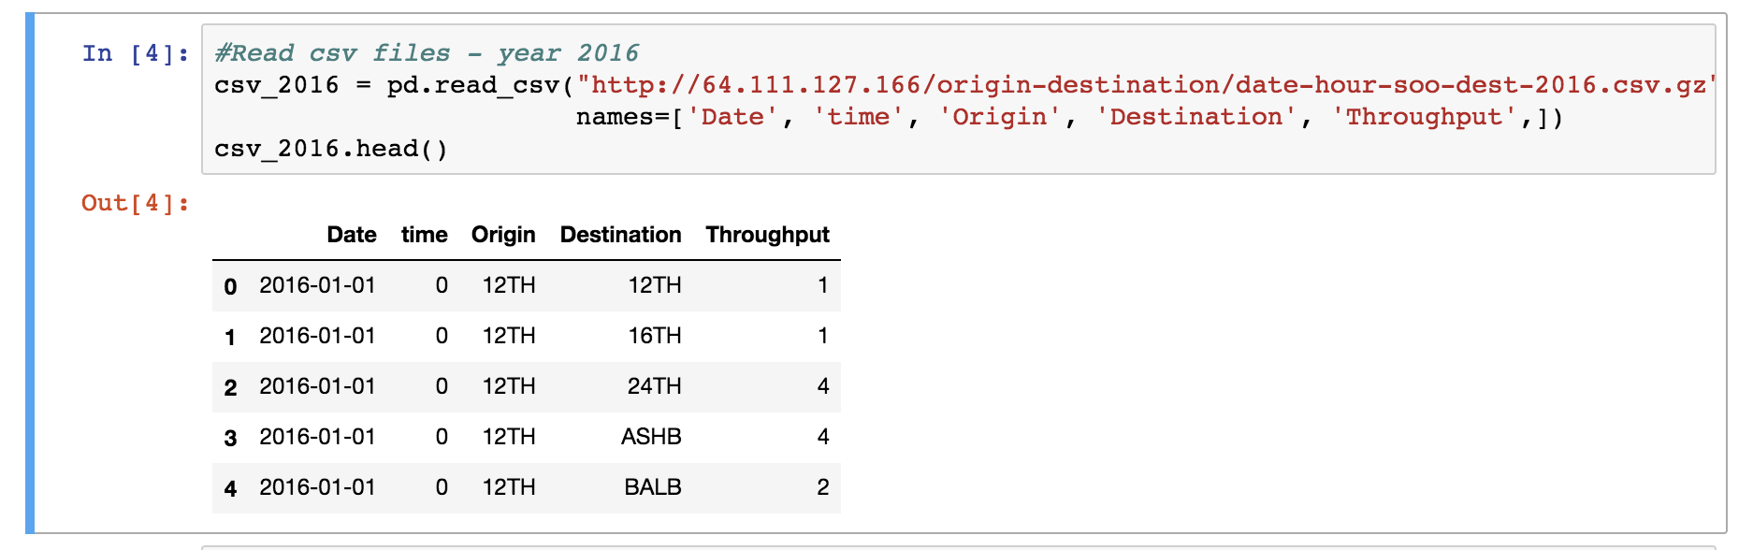
Code: Key Learnings
No need to download a large CSV file if a link to it is already available

Slide 8
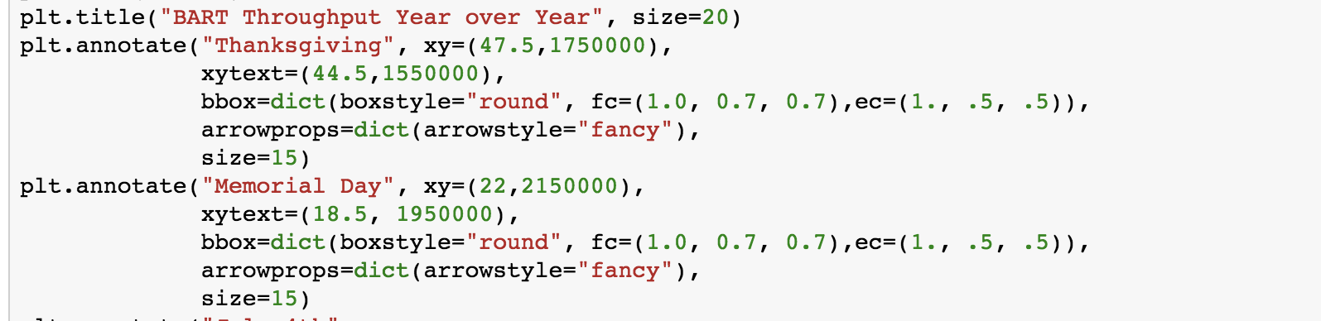
Code: Key Learnings
Annotate: Add notes directly to the chart

Slide 9
Super Bowl Impact– Origin station (Jan-Feb)

Slide 10
Super Bowl Impact– Destination (Jan-Feb)

Slide 11
Weekday Impact

Slide 12
Key Learnings – Weekdays indexing
Before
After

Slide 13
Key Learnings – Side-by-Side bars

Slide 14
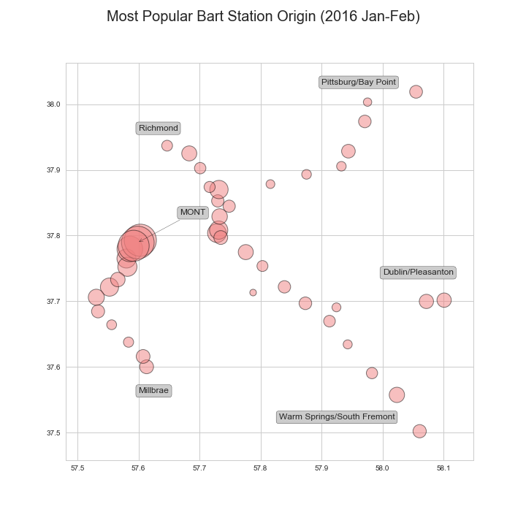
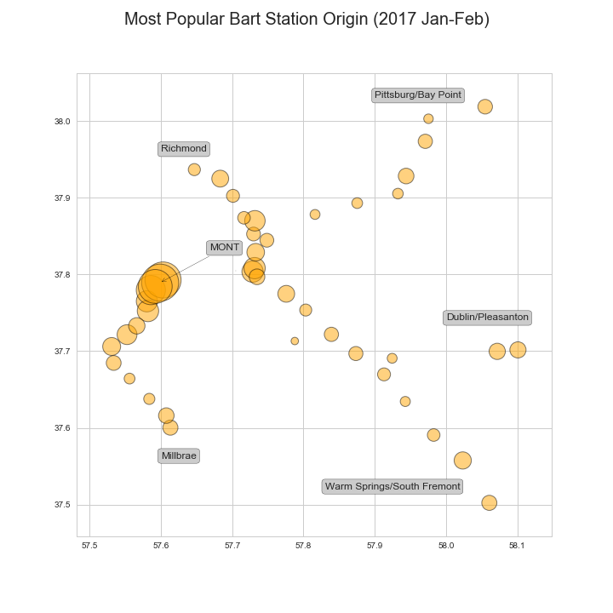
Super Bowl Impact– Origin station (Jan-Feb)

Slide 15
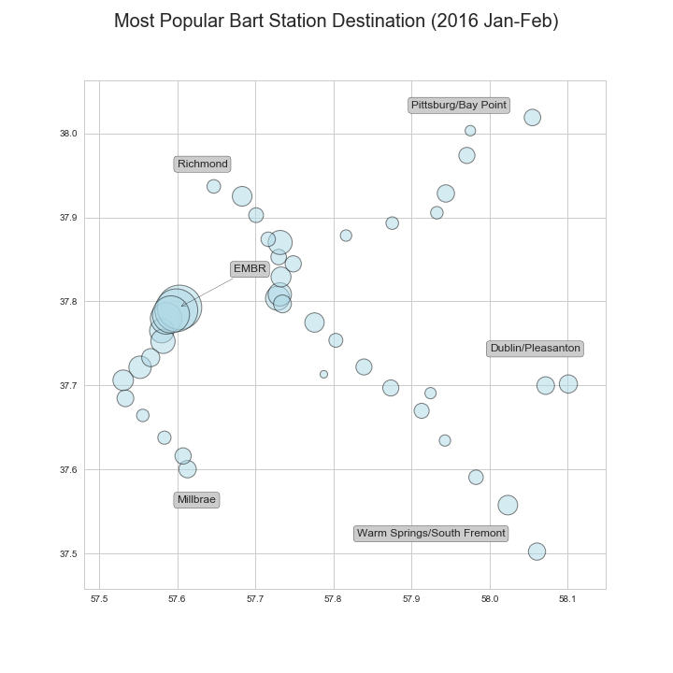
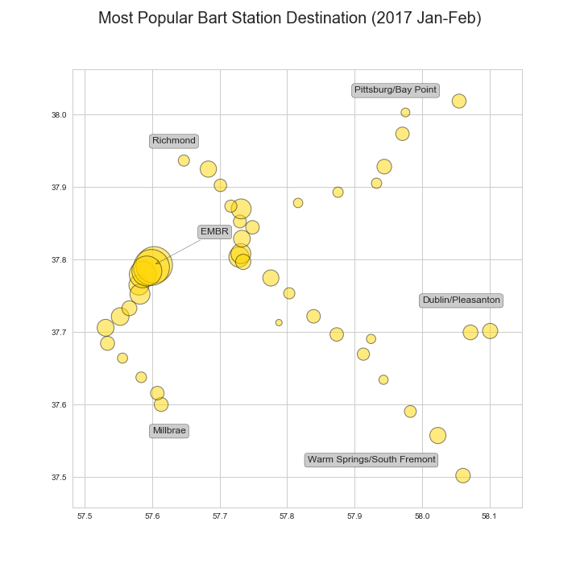
Super Bowl Impact– Destination (Jan-Feb)

Slide 16
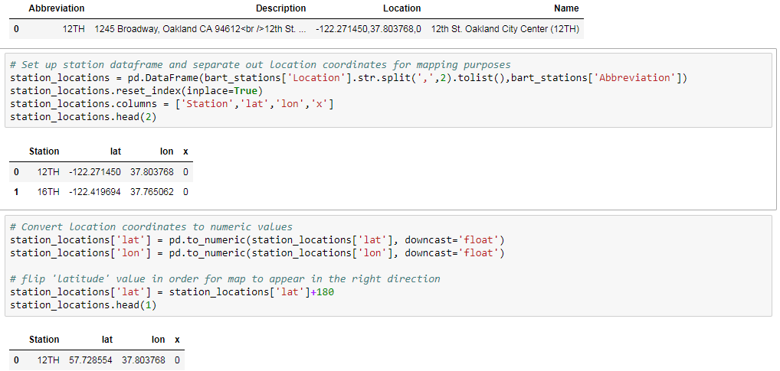
Key Learnings – Code
Station Location mapping required: Splitting out coordinates, converting to numeric and flipping direction:

Slide 17
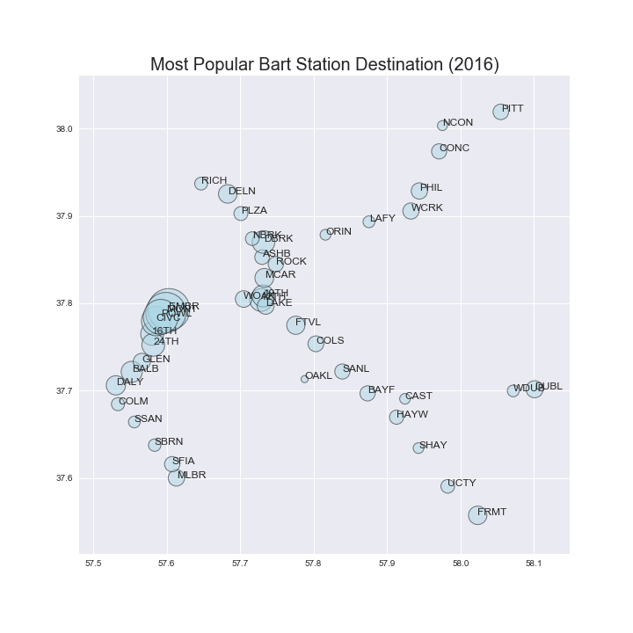
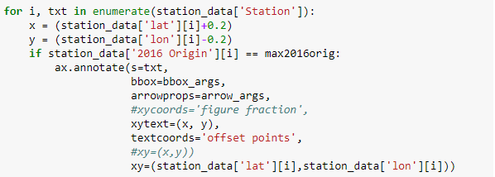
Key Learnings – Focus on Question
Original plan: add station names to all data points
Final result: add end point stations only and highlight most popular station

Slide 18
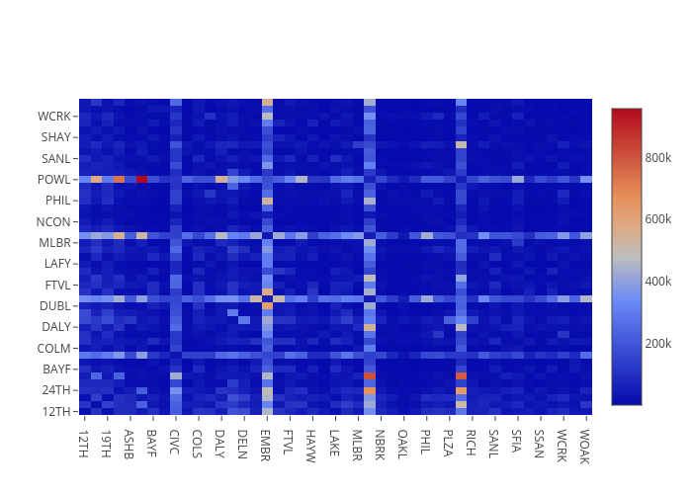
Throughput Between Stations (2015)
https://plot.ly/~tli2001/8/

Slide 19
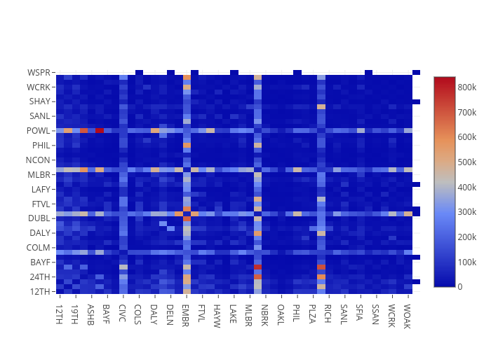
Throughput Between Stations (2016)
https://plot.ly/~tli2001/4/

Slide 20


Popular Station Findings
Comparing the throughput of January-February of 2016 and 2017, there was an overall decrease in traffic in the year following the Super Bowl. We saw an average drop of 33,000 across all stations, including a drop of over 200,000 in the most popular destination station in both years – Embarcadero Station.
Looking at the full year throughput between 2015 and 2016 (2017 data was incomplete) we can see that the overall traffic pattern between stations looked largely similar, so the Super Bowl primarily added volume but did not alter the traffic pattern .
Verdict: If you need to travel to or through downtown San Francisco - specifically Embarcadero, Montgomery, Powell, or Civic Center, there’s a high possibility of the trains being packed due to the popularity of these stations.

Slide 21
BART Delays
By: Lena

Slide 22
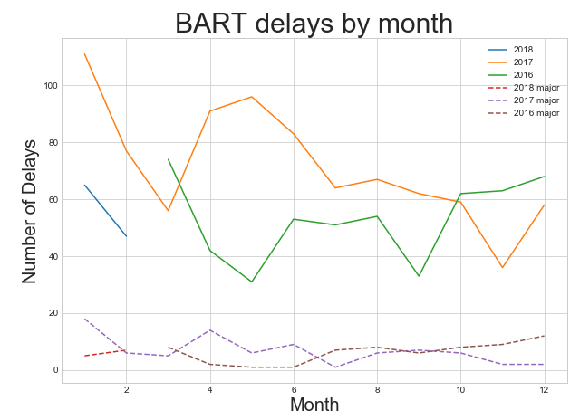
Question: Does BART have more delays during the winter?
2017 January rain days: 17
2018 January rain days: 11
Question: Are there good months to ride the BART?
Average delays: 67
Average major delays: 7
Year by year delays can be significantly different.
July to November are low delay months.

Slide 23
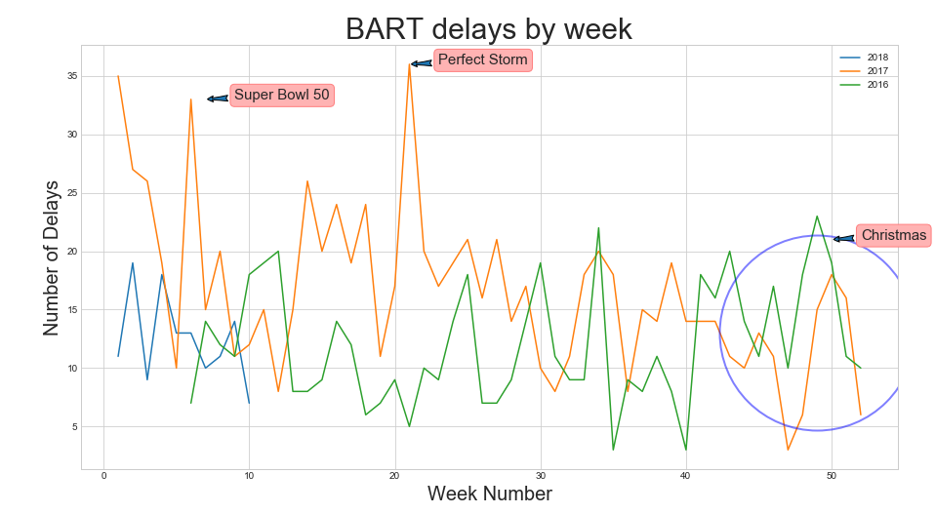

Slide 24
The Analysis
Core Message
Based on the data gathered, there is an average of 2 delays per day.
Data Source
BART API does not have delay data.
Overcoming Twitter API’s 7 days limit.
Weather underground for weather data.
Data Exploration and Cleanup/Assumptions
Text search: Filtered out tweets that says: BART Recovering
Only considered tweets that includes DELAY. Example: Station closed
Data Analysis
Used groupby to find the occurrence of delays and major delays.
More in depth analysis can be done.
Find the length of delay (10 mins). However, this may not be accurate or some tweets doesn’t even mention delays.
Find the stations affected by delay. The format of tweets are inconsistent.

Slide 25
The Analysis
Implication of Findings
BART does have its up and downs in terms of service interruptions. It is good for Lyft and Uber services.
It would be interesting to see how BART performs over 5 year period. Currently there’s no data source for long period.

Slide 26
BART Green Energy Quick Facts
2016 average number of weekday trips..................................433,394
Average trip length................................................................14.7 miles
Gallons of gas saved by avoiding driving (round trip)............1.4 gallons
CO2e avoided in one average round trip............................27.0 lb CO2e
(Source: www.BART.gov)
Other Benefits:
Avoid expensive parking
Avoid traffic delays
Avoid wear and tear of car

Slide 27
Branch 4 BART Project
Q & A

Slide 28
Appendix

Slide 29
Resources used
Bart.gov ridership raw data: http://64.111.127.166/origin-destination/
Twitter API

Slide 30
Key terms
Throughput: Number of people that click in/out of a station

